Slide 1
Selling Ames
An investigation of the local housing market of Ames, IA

Slide 2

Ames Iowa: A land of Real Estate Opportunity
Ames, Iowa.
Location of Iowa State University.
Even Market, with a minor break for sellers.
Opportunity to sell for a good price at a relatively low cost of entry.

Slide 3

Buying and Selling in Ames
Quality of housing quite varied.
College Town (Real Estate Near Campus even more profitable)
Mean price at $338,000 (Below average in the US)
Sporting and cultural events, an opportunity for short-term rental.

Slide 4
Strategy
How to play this market?
Speculation! The large student body (Housing needed for ~20,000 upperclassmen).
College towns attract recent alums for companies, service people, professors, etc.
Ames is stable in population, but has grown substantially over the last 30 years, with another increase in the last 3.
How to sell to prospective landlords, new residents, or those looking to upgrade?

Slide 5

Science can Help!

Slide 6
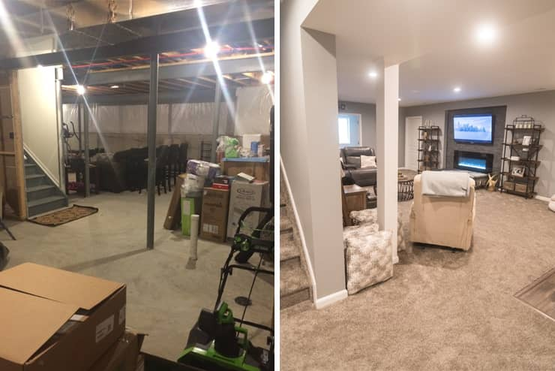
Data Modeling and the Housing Market
There are many similarities and differences that might play into the price of a house.
Some are fairly obvious. Larger houses with fewer problems naturally sell for more, for example.
Certain features also drive the price upward.

Slide 7
Assumptions
Depending on your inclination to flip a property vs. use it as a rental, there are a few additional assumptions to be made.
Namely, certain aspects such as proximity to Iowa State University (no more than a 35 minute drive from campus for landlords), as well as at least four bedrooms and bathrooms, to maximize rental income.
For those hoping to flip and those hoping to rent, the variables being tracked here should still largely be the same, the only difference would be the approach to these considerations. The flipper should consider these traits things to improve upon in a house, while the landlord should consider these as things to keep in good, solid condition for an eventual resale.

Slide 8

Maintaining and Growing Property Value
Notes:
Now, for the fun part, looking at the data and making some decisions around statistical significance as well as overall impact. For this, we’re going to use a dataset from Kaggle, looking at property values here in Ames. It also contains over 70 other details about the homes in question, ranging from details such as square footage and presence of things like garages, to minute details such as whether the driveway leads to a main road or an alleyway, or whether or not an outdoor porch is covered.

Slide 9

What to look for…
Correlation.
Best fit for this analysis.
Six Key Variables, plus one extra.
Notes:
When it comes to this dataset, the 79 variables can seem a bit overwhelming, and it might seem a bit easy to get lost in the minutia. Thankfully, most of these variables aren’t that important when it comes to understanding their effect on sale price. Key to this is understanding the strong correlations. Only those variables with a correlation to sale price above 50% or .5, will be used for this analysis. That takes 79 variables down to only six, with another variable made from another variable in those six.

Slide 10
The “Essentials” of Reselling:
Overall Quality
Overall Condition
Year Built
Year Remodel Added
Garage Area
Remodeled before or after 2000?
Notes:
And when it comes to these variables, all of which seem to have a large impact on the sale price of a house in Ames, we can create a relatively simple statistical model to plot the exact relationship between Sale Price and these six variables. In the final case, the question of whether or not a remodel was added before or after 2000 is simply to make a determination about recency, if remodels ‘go bad’ from a buy perspective if they are especially old.

Slide 11
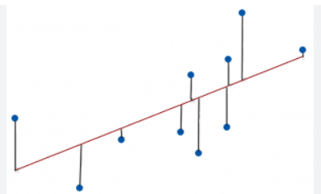
Modeling:
Notes:
Now, for this analysis, I chose to use a simple linear regression or Ordinary Least Squares (OLS) Model, simply because in a situation with somewhat few variables with strong correlations, a deeper model is simply unnecessary, especially when this model accounts for over two-thirds of variation in the most key variables. It should also be noted that regression is not to be confused with simple correlation, as while a correlation may provide a general idea of the relationship between two variables (mainly positive or negative), a regression is much more precise, finding the exact multiplier for each independent variable’s direct impact on the dependent variable.

Slide 12
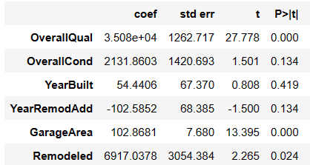
Findings:
Notes:
When it comes to these variables, there are a lot of strong results here, as each variable gives a marked change in the sale price of a house. Most notably, all but one of the variables in question have positive coefficients, meaning that an increase in these are associated with a rise in the price of a house. The lone exception is that of the year whence a house was remodeled. Curiously, more recent remodeled houses actually reduce the sale price, while the variable “Remodeled,” tracking whether or not the remodel occurred before or after 2000, was positive. In this context, it seems that a very recent remodel is beneficial, implying that an outdated remodel may scare away a potential buyer, while a recent one may help maintain the buyer’s interest, in fact stronger than any other factor. That being said, condition, recency, and garage space are also strong variables, with all of them making the sale price of a house at least 54 times higher on the low end, and over 2100 times on the high end (Overall Quality is around 48 times, per Euler’s Number). It should be noted as well that the majority are statistically significant, meaning that they cannot be attributed to chance. In fact, Overall Quality and Garage Area are perfect zeroes, meaning a causative relationship is almost certain.

Slide 13
Conclusion:
Most of these principles are fairly intuitive. Houses in better condition and of higher build quality naturally resell for more money.
What is perhaps the most odd aspect of this is the relational change in effect of remodels. It seems that remodels from the previous two decades are in demand, and older remodels largely irrelevant, but “in-between” remodels are instead detrimental.
This suggests that a remodel is a sound investment when planning to resell property. The budget for such a remodel should be plotted against the potential increase in sale price (a professional appraisal may also be helpful here).

Slide 14

Questions?

